Slide 1
GIT AND GITHUB

Slide 2
I. INTRODUCTION II. GIT & GITHUB III. FORKING A REPOSITORY IV. Committing to your fork V. Issuing a pull request VI. Syncing your fork
agenda

Slide 3
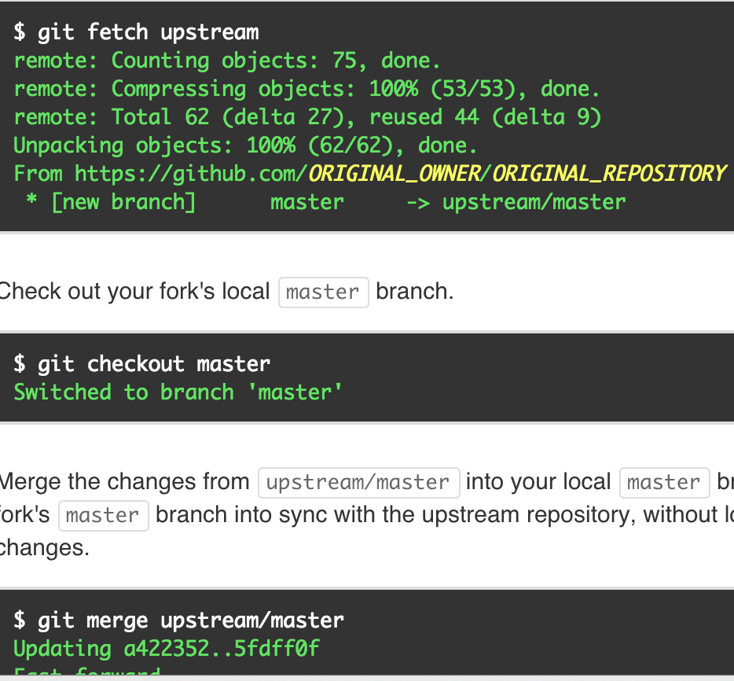
Why SHOULD I learn version control?
Version control lets you control how your code is edited and used – and really helps when you’re recovering from a breakage!
It also enables teams to easily collaborate on the same codebase.
It enables you to contribute to open-source projects.
And, it’s an attractive skill for employment!

Slide 4

Git
Git is the most widely used version control system today.
Git tracks files and file changes in a repository (called a “repo”).
Repos are usually ‘pulled’ (downloaded), ‘pushed’ (uploaded). Repos can also be ‘cloned’ or ‘forked’.
Push/pull commands are run from the command line.
Notes:
Alternatives to Git are subversion, mercurial

Slide 5

Github
GitHub is a website, not a version control system!
GitHub allows you to put your Git repos online.
Benefits of GitHub:
Backup of files
Visual interface for navigating repos
Repo collaboration via ‘forking’
GitHub requires Git, but Git does not require GitHub!
Notes:
Alternatives to Git are subversion, mercurial

Slide 6
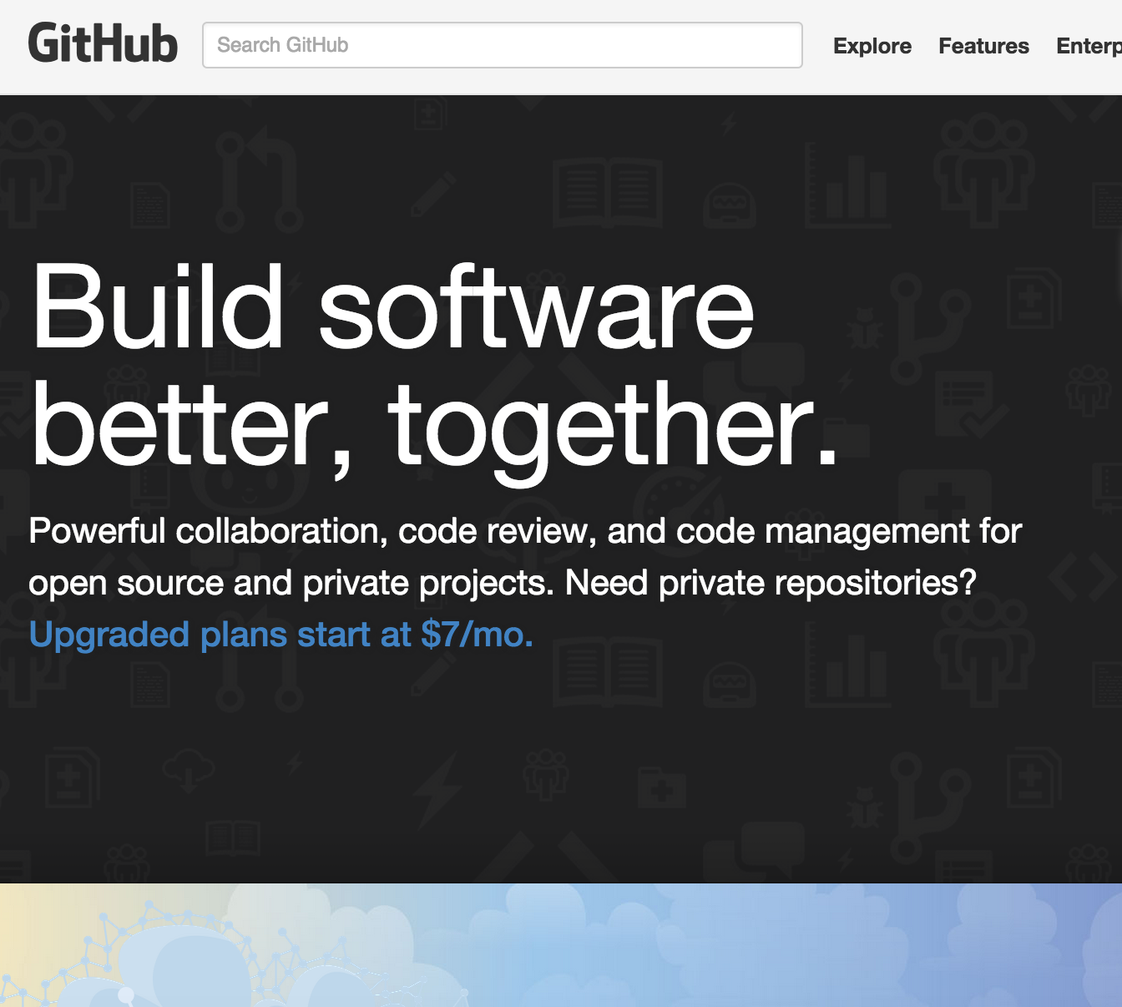
Github setup
Create an account at http://github.com/.
Download the GitHub GUI client (available for either Mac or PC) and link it to your GitHub account. Links to both download URLs are on the class homepage.
Navigate to:
https://github.com/bbalin12/DAT5_BOS_students.
Notes:
Alternatives to Git are subversion, mercurial

Slide 7

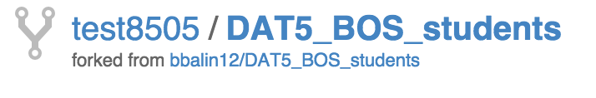
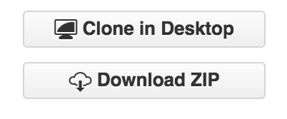
FORKING a REPOSITORY
On DAT5_BOS_students, click the ‘Fork’ button in the upper-right hand side of your screen.
Navigate to your newly-created fork – it should look like {yourname}/DAT5_BOS_students.
Click ‘Clone in Desktop.’
Notes:
Alternatives to Git are subversion, mercurial

Slide 8
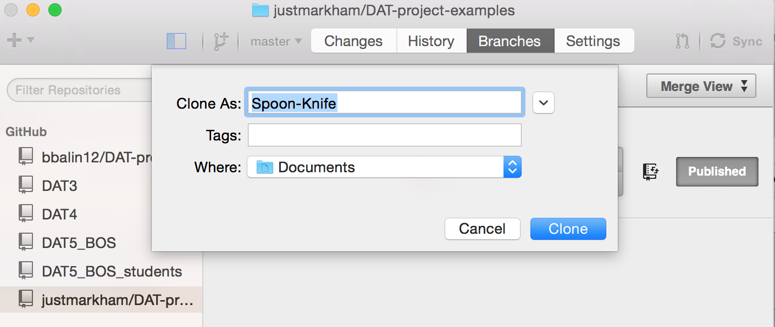
FORKING A REPOSITORY
Your GitHub GUI client should automatically open.
Designate the folder name you will clone the repo into, as well as where you will be saving the folder.
You should now see the cloned repo in your ‘My Documents’ or equivalent folder.

Slide 9
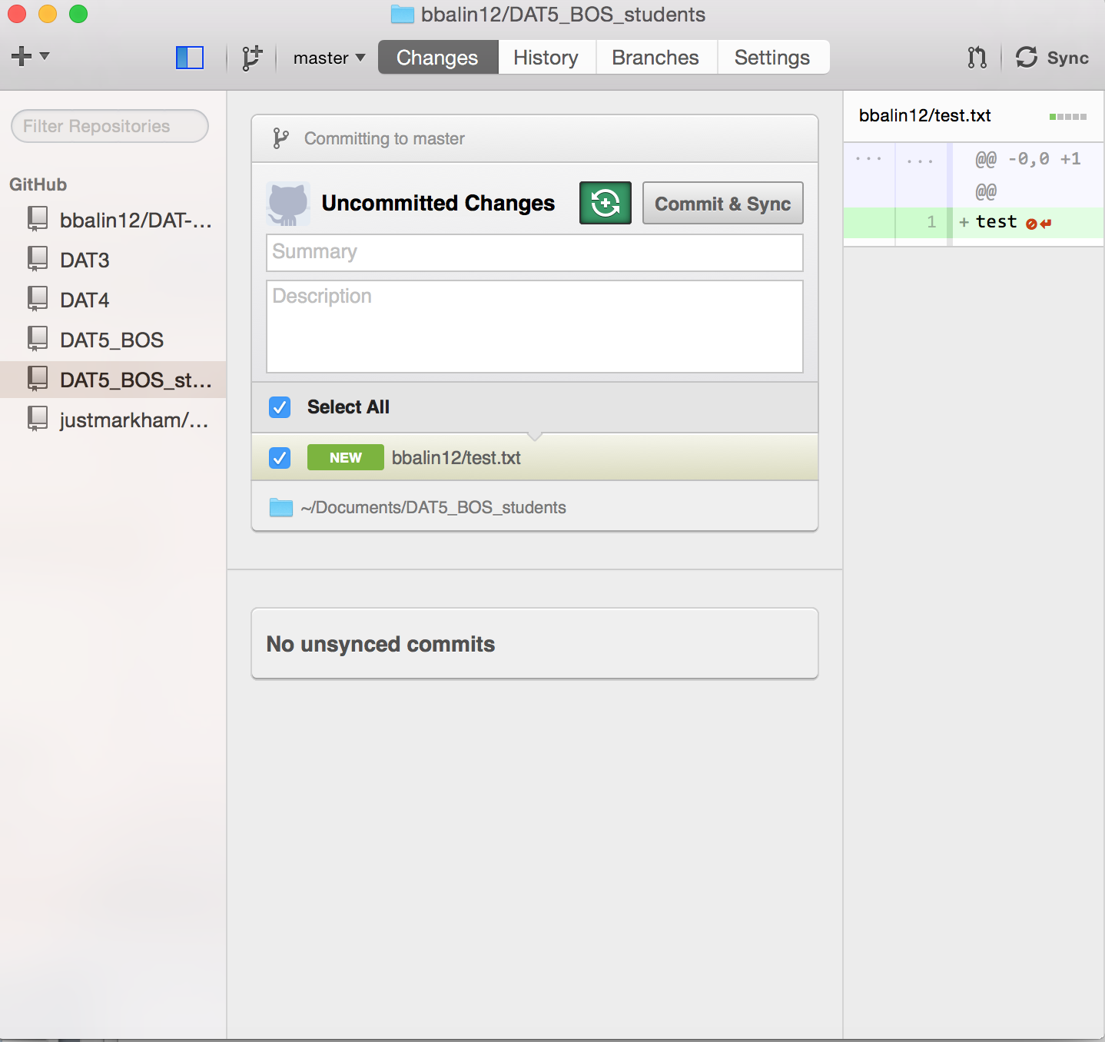
COMMITTING TO YOUR FORK
Create a new folder within your fork of the DAT5_BOS_students repo. It should have the same name as your desired user name (mine is bbalin12).
Save your Pandas homework to that folder.
Go back to your GitHub GUI. Under DAT5_BOS_students, you should see your folder and file listed under ‘Uncommitted Changes.’
The contents of your file should appear to the right.

Slide 10
COMMITTING TO YOUR fork
Under ‘Summary’, write a summary of the changes you made.
Click the gray button with two circular arrows next to ‘Uncommitted Changes’ to both commit your work locally and sync your work to your remote GitHub fork. The button should turn green once you do this.
Click ‘Commit and Sync’.

Slide 11
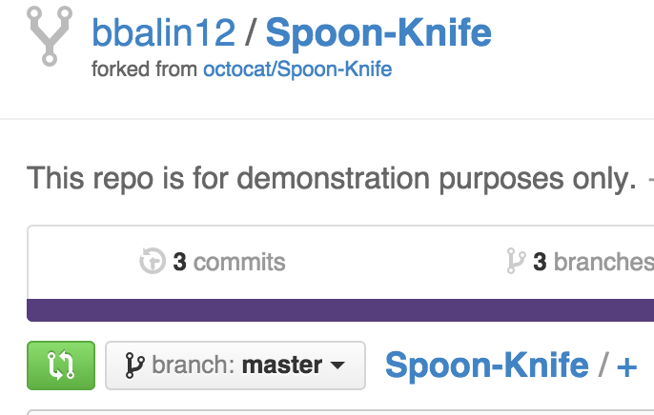
Issuing a pull request
You’ve now committed your changes to your remote fork of the DAT5_BOS_students repo.
Now, click on the green button with two circular arrows to the right of the ‘branch: master’ button (see graphic to the right).

Slide 12
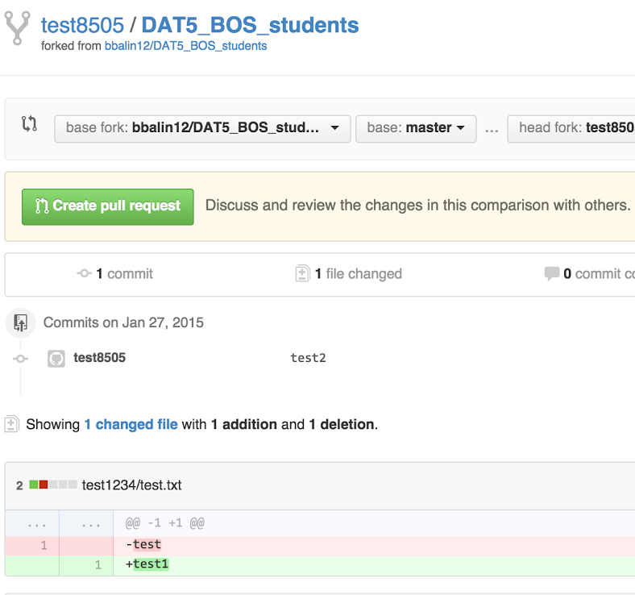
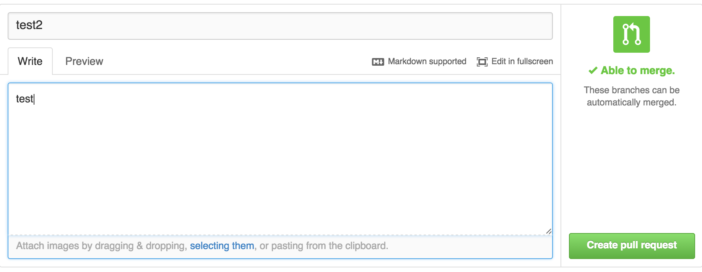
Issuing a pull request
On the next page, you should see your changes. Click the ‘Create Pull Request’ button to submit the request to the base master repo.
On the next page, put a message in for the pull request, and click ‘Create Pull Request’ again.

Slide 13
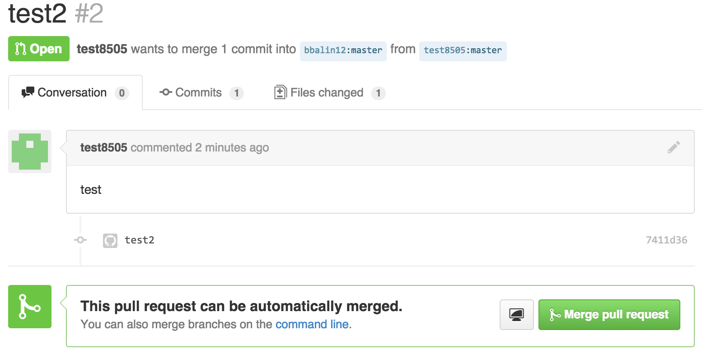
Issuing a pull request
You should see a confirmation page.
On my end, I will receive a pull request e-mail with the link to the page below. If I click ‘Merge pull request’, your changes are automatically uploaded and included in the master DAT5_BOS_students repo.

Slide 14
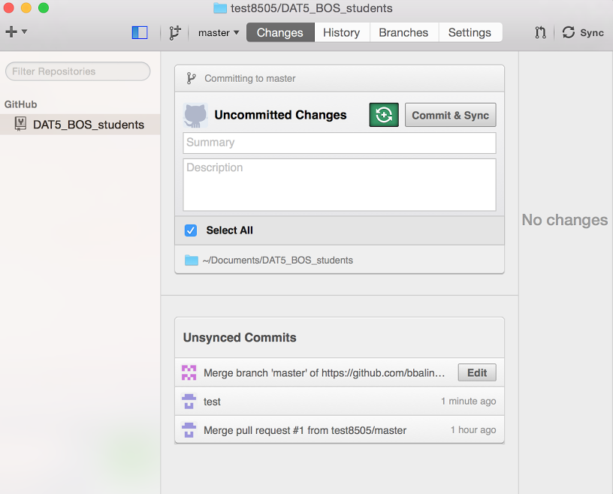
Syncing your fork
To pull changes to the master repo made by other users into your fork, click the ‘Sync’ button in the upper right hand of the GitHub GUI.

Slide 15
Questions?
GIT AND GITHUB

